Slide 1
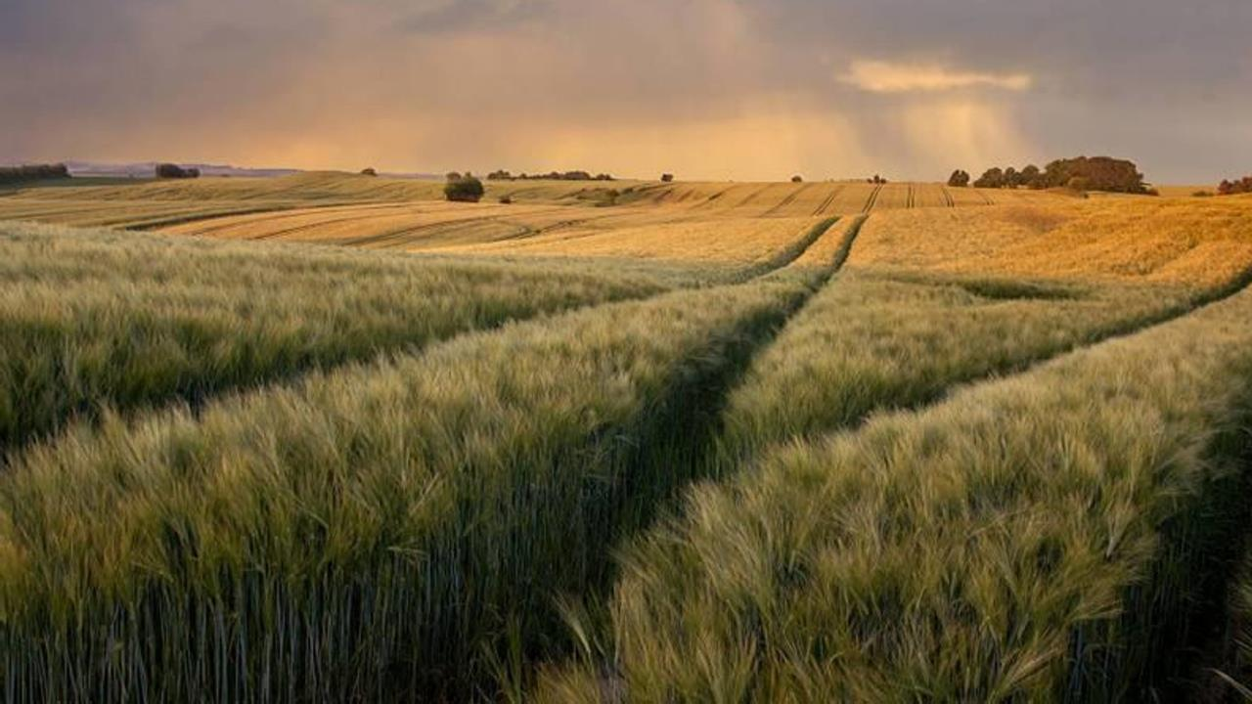





GLOBAL ECOSYSTEM CLASSIFIER
Capstone Project
Data Analytics Bootcamp 2024 Cohort no. 2

Slide 2

GLOBAL ECOSYSTEM CLASSIFIER
MEET THE TEAM
ALEXANDER SCHMIDT
Data acquisition & maintenance
SOMA PASUMARTHY
Web dev & database maintenance
NOAH KÜRTÖS
Data acquisition & model interpretation
HEIKO FRÄMBS
Project management & communications

Slide 3


INTERACTIVE PLATFORM FOR ECOSYSTEM CLASSIFICATION USING HISTORICAL SATELLITE DATA WITH FUTURE CHANGE FORECASTS
OPEN ACCESS SOURCE
GLOBAL ECOSYSTEM CLASSIFIER
PROJECT GOALS
OPEN AND EASY ACCESS SOURCE FOR ORGANIZATIONS AND PUBLIC
GENERATE REGION-SPECIFIC PREDICTIONS, SHOWING HOW LOCAL ECOSYSTEMS ARE LIKELY TO CHANGE BASED ON PAST TRENDS
INTERACTIVE PLATFORM FOR ECOSYSTEM CLASSIFICATION USING HISTORICAL SATELLITE DATA WITH FUTURE CHANGE FORECASTS

Slide 4
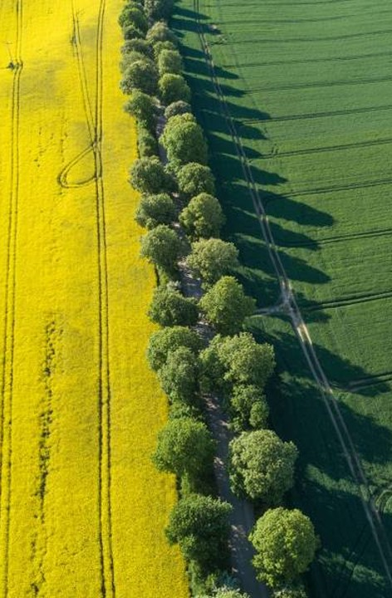







DEFINING CLASSIFICATION PARAMETERS
SATELLITE DATASETS
ECOSYSTEM CLASS
VIIRS Radiation Data
Urban
Buildings
MODIS Vegetation Data
Temperate
Forest
GLDAS Land Assimilation Data
Hot
Desert

Slide 5


DEFINING CLASSIFICATION PARAMETERS
SATELLITE DATASETS
ECOSYSTEM CLASS
VIIRS Radiation Data
Urban
Buildings
Global
0.25° Longitude x 0.25° Latitutde
(ca. 10km x 10km)
MODIS Vegetation Data
Temperate
Forest
GLDAS Land Assimilation Data
Hot
Desert

Slide 6

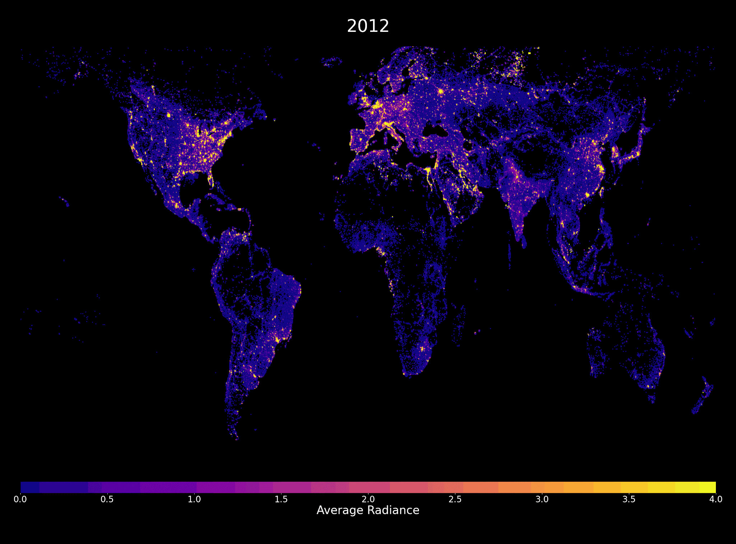

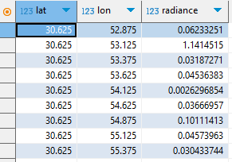


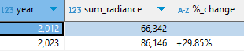
VIIRS Radiation Data Nighttime Lights
DEFINING CLASSIFICATION PARAMETERS
GLOBAL GRID OF ENVIRONMENTAL PARAMETERS
PROXIES FOR ECOSYSTEMS
NIGHT LIGHT: BUILDINGS

Slide 7
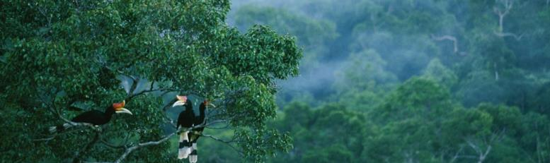
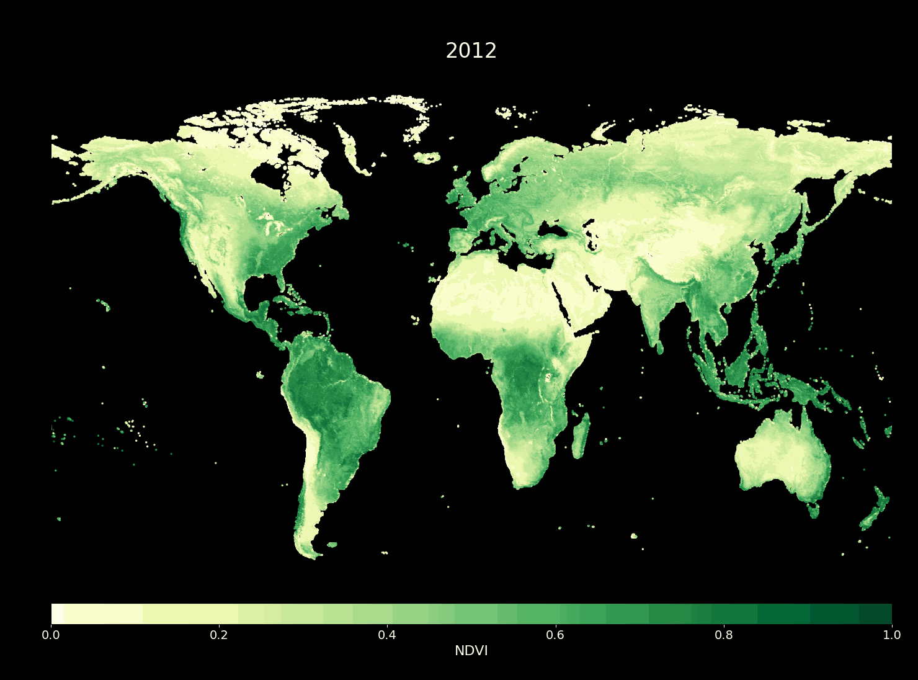
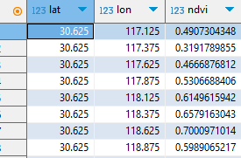


MODIS Vegetation Data Normalized Difference Vegetation Index (NDVI)
DEFINING CLASSIFICATION PARAMETERS
GLOBAL GRID OF ENVIRONMENTAL PARAMETERS
PROXIES FOR ECOSYSTEMS
NDVI: FORESTS

Slide 8
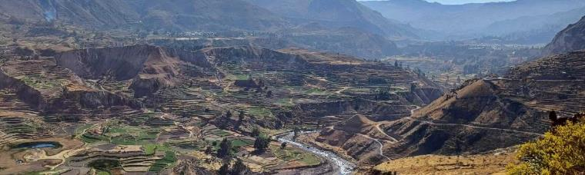
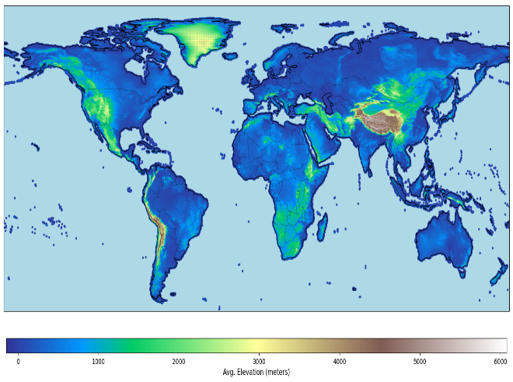
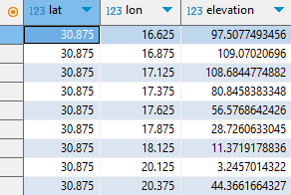


Copernicus Elevation Data
DEFINING CLASSIFICATION PARAMETERS
GLOBAL GRID OF ENVIRONMENTAL PARAMETERS
PROXIES FOR ECOSYSTEMS
Elevation: MOUNTAIN

Slide 9

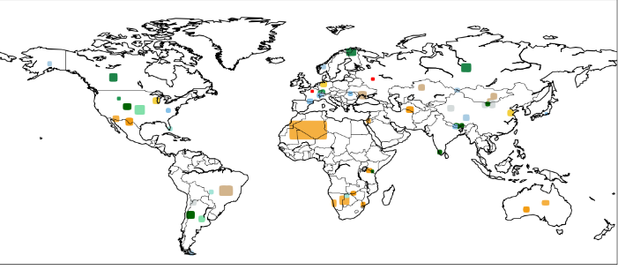
GLOBAL ECOSYSTEM CLASSIFIER
~300 000 pixels
~100 parameters
15 ecosystems
TRAINING DATA:
RANDOM FOREST
builds multiple decision trees using random subsets of data and features, then combines their predictions to obtain a singular prediction.

Slide 10
ECOSYSTEM
~300 000 pixels
~100 parameters
15 ecosystems
Urban
Buildings
Artificial
Agriculture
Fields
Grassland
Steppe
Savannah
TRAINING DATA:
Meadow
Swamp
Forest
Boreal/Taiga
Temperate
Natural
Tropical
Montane
Montane forest
Alpine tundra
Subalpine
Desert
Semi-arid
73 representative training points
10% training data
100 estimators
Cold
Hot

Slide 11
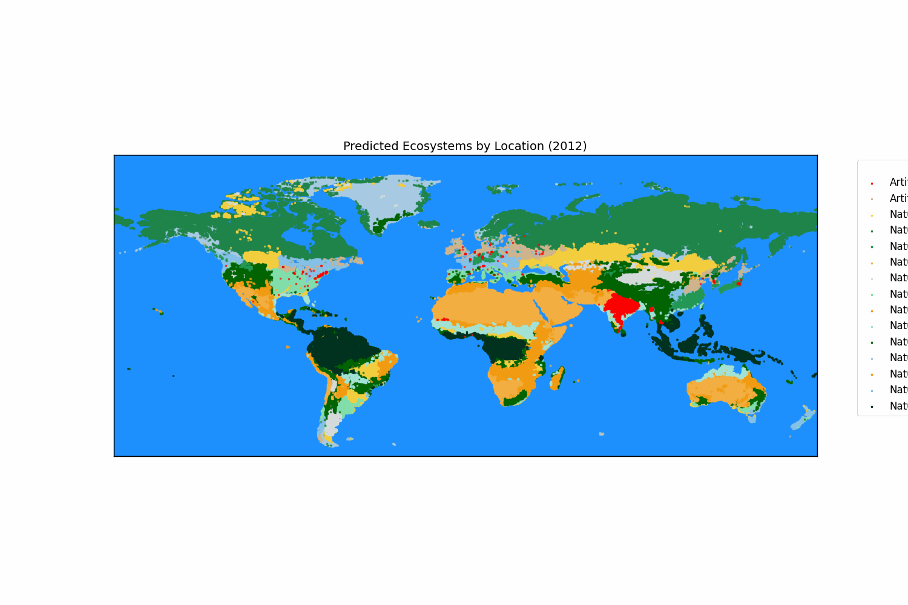

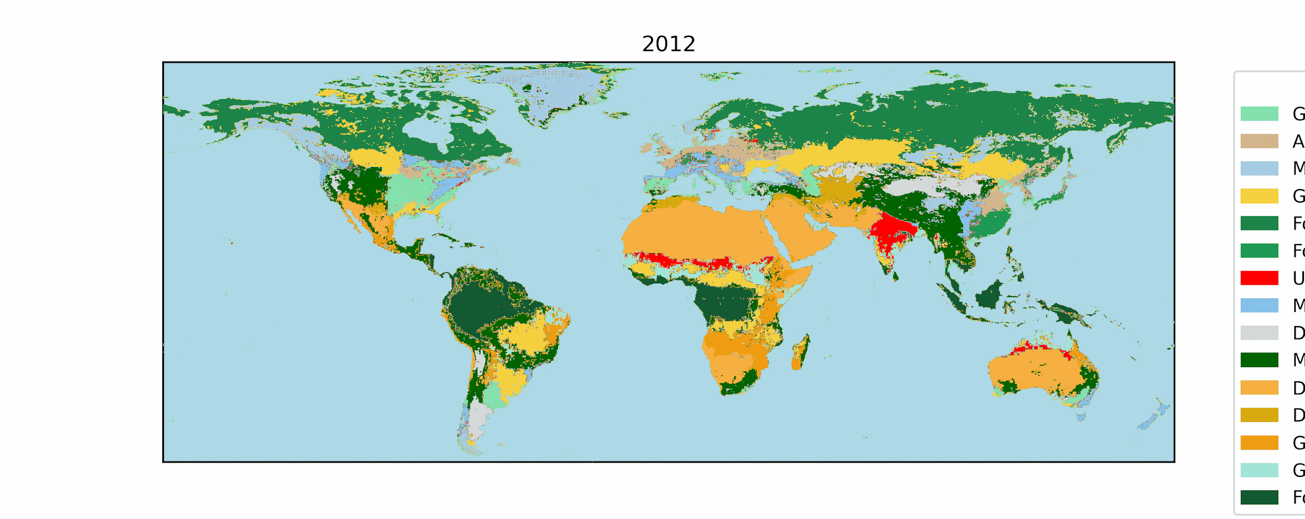
ECOSYSTEM
Urban
Buildings
Classification 2012 - 2023
Artificial
Agriculture
Fields
Grassland
Steppe
Savannah
Meadow
Swamp
Forest
Boreal/Taiga
Temperate
Natural
Tropical
Montane
Montane forest
Alpine tundra
Subalpine
Desert
Semi-arid
Cold
Hot

Slide 12
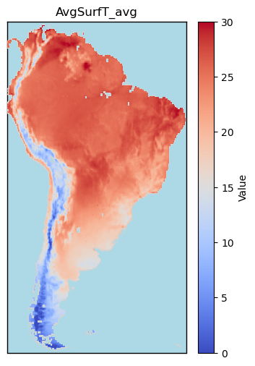
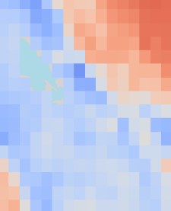
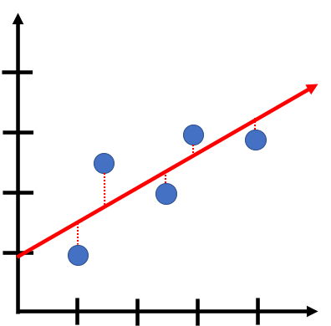
GLOBAL ECOSYSTEM PREDICTIONS
2020
Mean surface temperature [°C]
Fetch Parameter per pixel
Linear regression per pixel
Predict values per pixel
LINEAR REGRESSION
fits a straight line to the data by minimizing the difference between actual and predicted values, modeling the relationship between independent and dependent variables.
PARAMETER
YEAR

Slide 13
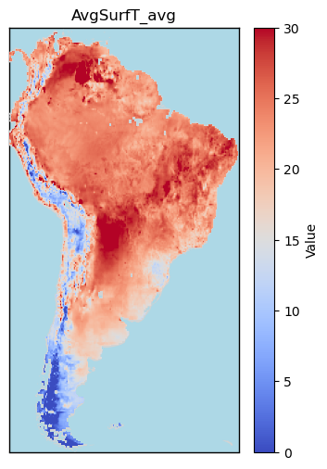
GLOBAL ECOSYSTEM PREDICTIONS
2020
2050
Mean surface temperature [°C]
Mean surface temperature [°C]
LINEAR REGRESSION
fits a straight line to the data by minimizing the difference between actual and predicted values, modeling the relationship between independent and dependent variables.

Slide 14
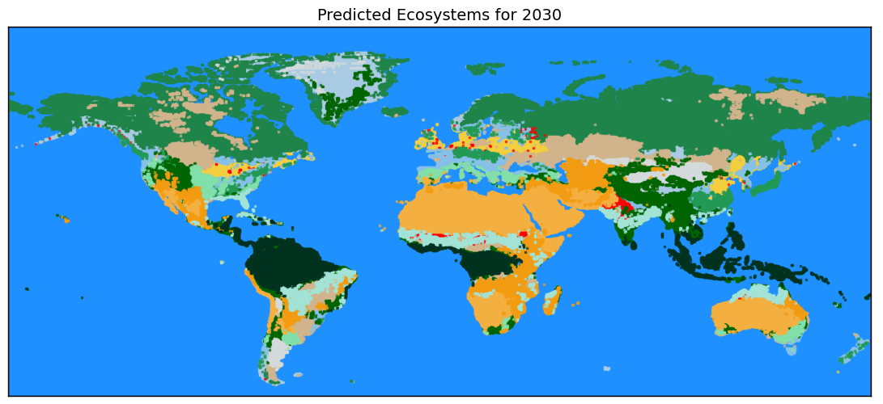
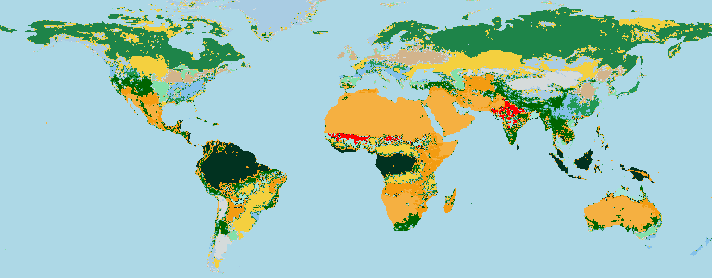
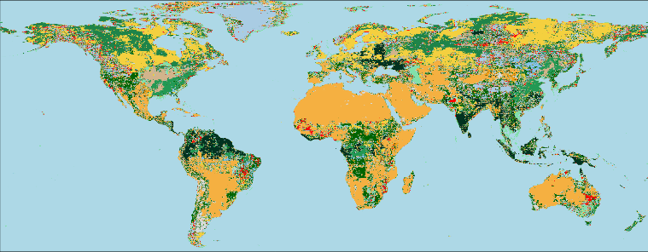
ECOSYSTEM
Urban
Buildings
Artificial
Agriculture
Fields
Grassland
Steppe
Savannah
Meadow
Swamp
2030
Forest
Boreal/Taiga
Temperate
Natural
Tropical
Montane
Montane forest
Alpine tundra
Subalpine
Desert
Semi-arid
Cold
2100
Hot

Slide 15
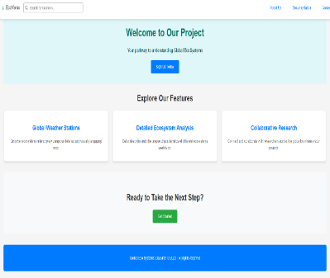
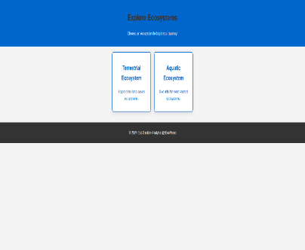
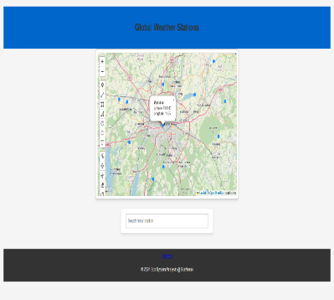
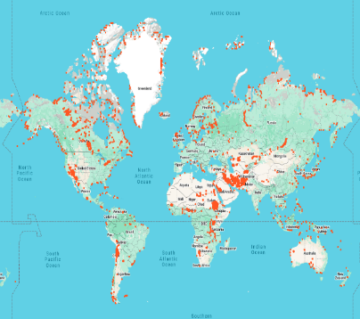
EcoVerse
Frontend:
🛠️ React: Dynamic, responsive UI.
🎨 HTML5 & CSS3
Backend:
⚙️ Node.js & Express
💾 PostgreSQL
Interface:
🔗 REST APIs: JSON over HTTPS
Hosting & Deployment:
☁️ AWS
Authentication & Security:
🔐 Data Encryption
🗝️ EcoVerse-Key
🔑 EcoVerse-Nonce
Map Component:
📍 Leaflet:
🌍 Google Maps:

Slide 16

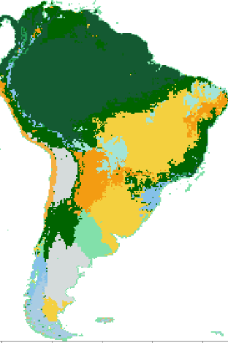


OPEN ACCESS SOURCE
GLOBAL ECOSYSTEM CLASSIFIER
RECAP
Global ecosystem visualisation and classification
Validate and improve our model
Implement predictions into webpage

Slide 17

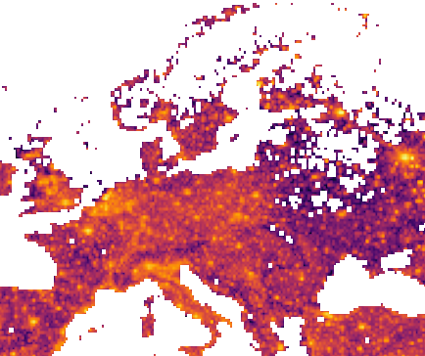
Thank you
for your attention!
Capstone Project 18.11.2024
“Data Analyst bootcamp” @neuefische
by Alexander Schmidt, Noah Kürtös, Soma Pasumarthy & Heiko Främbs
https://github.com/NoahKuertoes/global_ecosystem_classifier
Sources:
https://ladsweb.modaps.eosdis.nasa.gov/missions-and-measurements/viirs/
https://ldas.gsfc.nasa.gov/
https://modis.gsfc.nasa.gov/
Pictures:
Sustainable Investing - Evidence Based Investing
https://www.istockphoto.com/
https://thaddeus-segura.com/linear-regression/
Peru Andes: Lea Graafen & Nawid Albinger

